Slide 1
UNBOXED Creations
CREST Discovery Day
SUPPORTED BY
IN PARTNERSHIP WITH

Slide 2
Aims and objectives
UNBOXED 2022 was a celebration of creativity. In 2022 there was a programme of events and experiences which happened across the UK, online and through broadcast. These were created by some of the brightest minds in science, technology, engineering, arts and maths (STEAM).
In today’s challenge, you will:
Learn about the innate creativity in science, technology, engineering and mathematics (STEM)
Explore awe-inspiring new ideas that come from brilliant minds in STEM and the arts working together in surprising and exciting ways.
Use what you learn to create your own idea for an UNBOXED Creation!
Notes:
An UNBOXED Creation is an unforgettable experience combining science, technology, engineering, arts and maths, or STEAM – you are likely to see that word throughout this Discovery Day.
This could be anything from a sculpture trail to a multimedia installation!
The STEAM approach aims to integrate STEM subjects with arts subjects, using engineering or technology in imaginative designs or creative approaches to real-world problems while building on a mathematics and science base.
Combining arts with other STEM subjects in this way helps us to:
Explore problems from different perspectives and approaches
Highlight the vital role of STEM in the arts
Think about STEM and the arts as interdependent not as totally separate subjects
Encourage innovation
Promote critical thinking
Draw on reasoning and design principles
Inspire creative solutions

Slide 3
Celebrating creativity and innovation – what is UNBOXED?
UNBOXED 2022: Creativity in the UK
Notes:
UNBOXED: Creativity in the UK was a celebration of creativity across all four nations of the UK (England, Northern Ireland, Scotland and Wales).
UNBOXED was made up of 10 projects dedicated to science, technology, engineering, arts and mathematics (STEAM), aiming to inspire new ways of thinking, creative collaborations and discovering new talent in our local communities. The 10 projects were a mixture of in-person and digital events, accessible for everyone, everywhere.
UNBOXED aimed to be the biggest and most ambitious programme to happen in the UK. It celebrated and promoted collective collaboration; this means that it encouraged professionals to work with other professionals and sectors they wouldn’t normally work with. It was an exploration of how our creativity has the power to change the world - how we can shape a better future for people and the planet.

Slide 4
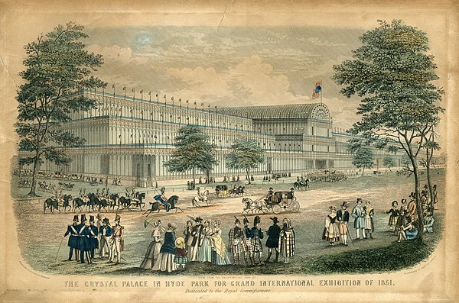
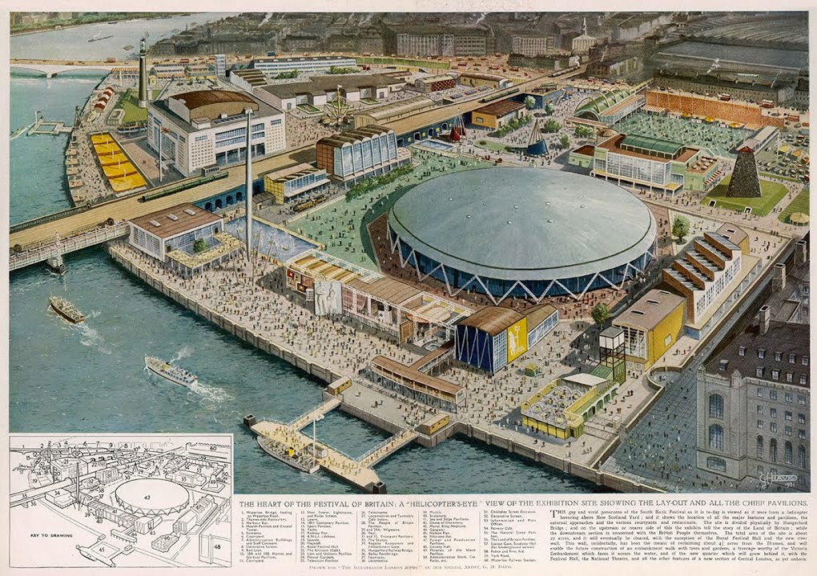
Celebrating creativity and innovation
1851 Great Exhibition
1951 Festival of Britain
Notes:
Festivals celebrating creativity and innovation date back to the 19th century. Two of the biggest examples are the Great Exhibition and the Festival of Britain.
The Great Exhibition (1851)
About
Took place in Hyde Park, London
The first in a series of World Fairs - exhibitions of culture and industry that became popular in the 19th century
Intended as a celebration of modern industrial technology and design, and for Britain to make "clear to the world its role as industrial leader“
Festival of Britain (1951)
About
Exhibition and fair in London is the summer of 1951
Lots of smaller festivals took place across the UK
Celebrated British scientists in the post war era – aiming for a feeling of recovery
Prompts
What similarities are there between UNBOXED 2022 and these previous festivals?
How did each festival bring together creativity and STEM?

Slide 5
Representation
The Great Exhibition of 1851 and the Festival of Britain in 1951 featured exhibits from cutting edge inventors, scientists, architects, engineers and more.
But at that time, not everyone was able to access that kind of profession. Nowadays access is more equal than in the past, but inequality in representation remains.
That’s why the UNBOXED programme included, lots of different voices.
DISCUSS:
Is representation important? Why or why not?
Notes:
Prompt questions
Do you think discrimination exists in STEM and/or the arts?
Representation is not only about discrimination, it is also about who has more access to opportunities for example. Which types of people do you think are not normally represented in
A) STEM
B) The arts
What kinds of things could be done to give a voice to people who are not normally represented in STEM and/or the arts? Have you seen any good examples of this?
Is representation important? Why or why not?

Slide 6
What do creativity and collaboration mean?
New projects are being created all the time by bright minds in science, technology, engineering, arts, and maths, bringing together an astonishing variety of people all over the UK: from scientists to musicians, designers to technologists, engineers to writers, architects to astrophysicists.
TASK:
Turn to page 5 in your student guide and complete the activity.
Does an idea have to be new to be creative?
Is looking at things from a different angle creative?
Does being creative need to involve solving a problem?
Notes:
Ask the class to brainstorm what creativity means to them. If you have internet connected devices to hand you could use a word cloud generator for this – otherwise write the students’ suggestions on the board.

Slide 7
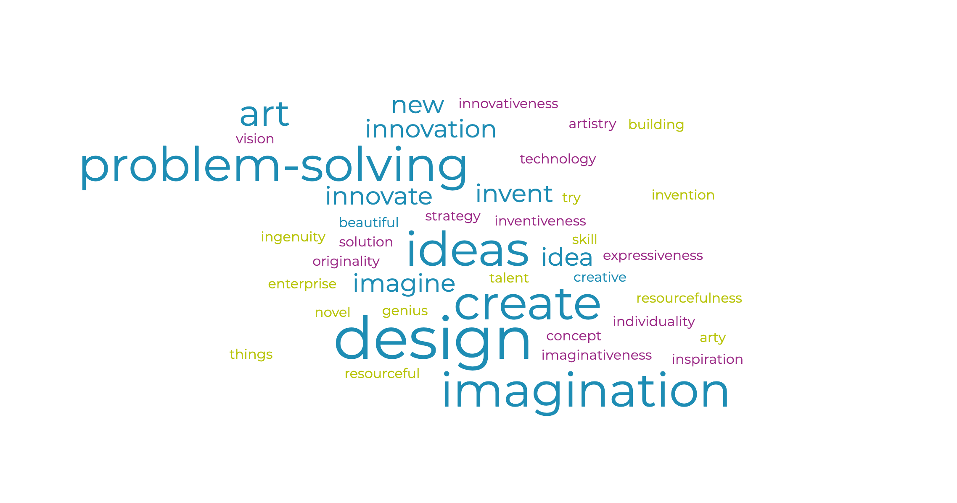
What is creativity?
Creativity is useful for solving problems, communicating with others, and entertaining ourselves and others.
Definition: “the ability to transcend traditional ideas, rules, patterns, relationships, or the like, and to create meaningful new ideas, forms, methods, interpretations, etc.; originality, progressiveness, or imagination:” ¹
¹ dictionary.com/browse/creativity

Slide 8
Creativity case studies
The Creativity Case Studies in your student guide show several different examples of innovative projects, from visitor attractions to interactive art installations.
TASK:
Choose 2 of the case studies from your student pack and discuss the different projects in your team:
How did the project combine the arts with STEM?
The aim of these projects was to be unforgettable, open, original and optimistic - do you think they succeeded? Why/why not?
How was new talent showcased?

Slide 9
UNBOXED Creations – the challenge
TASK:
Your team challenge is to create your own UNBOXED Creation that celebrates innovation and creativity.
Your idea MUST:
Be an unforgettable experience​
Draw on expertise from science, technology, engineering, arts and mathematics (STEAM)​
Represent the arts, as well as two other STEM sectors.​
Your idea could:
Include people who don’t normally get to be involved
Include people working together in ways you wouldn’t expect e.g. a mathematician and a sculpture artist
Celebrate your local area
Focus on educating people about a specific topic

Slide 10
Your UNBOXED Creation Team
Project Manager
Makes sure the whole team and the project is on track.
Art director
Design the visual style and create the overall design of the experience.
STEM researcher
Research how your chosen STEM subject will be used in the event.
STEM researcher
Research how your chosen STEM subject will be used in the event.
Event manager
Responsible for planning the experience logistics.
Marketing Lead
Responsible for developing a marketing plan.
Notes:
Ask students to check their student guide for more detailed descriptions.

Slide 11
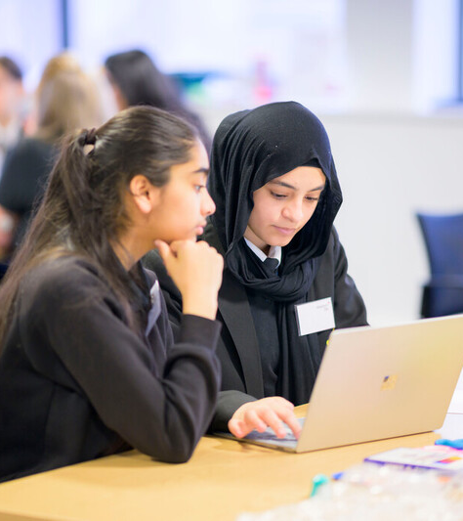
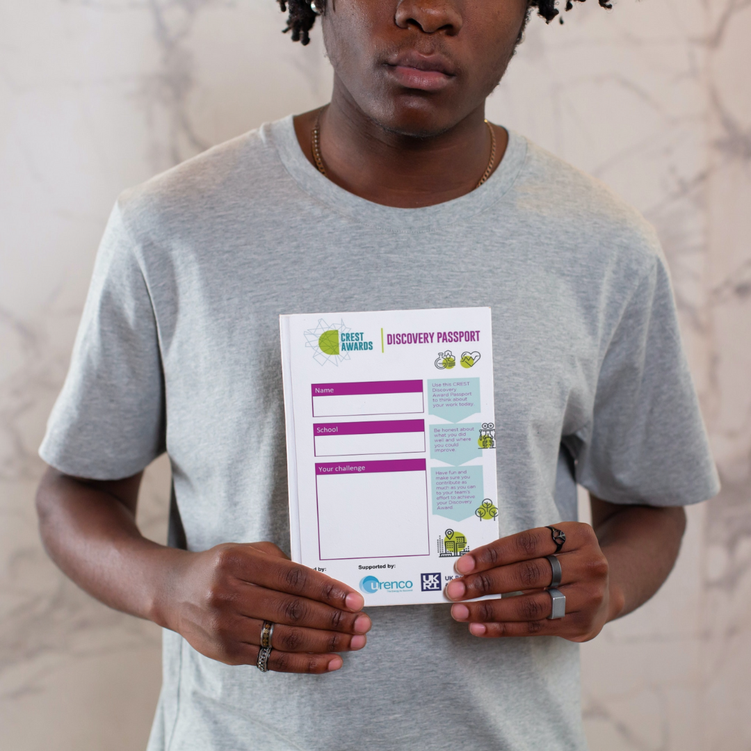
CREST Discovery Award
Fill out your CREST Discovery Passport throughout the day to show your learning and earn your CREST Award.

Slide 12
Present your ideas
Imagine the head of UNBOXED has invited you to present your UNBOXED Creation idea to them.
You will need to demonstrate teamwork, presentation skills, entrepreneurship and of course creativity.
Make sure you include:
Your idea and why you chose it
Target audience
Illustrations or visual aids

Slide 13
Plenary
Reflect on your project and fill out any gaps in your CREST Discovery Passport in order to earn your CREST Award.

